Slide 1
IMDB Web Scraping Project: Top 10 TV/Movies and Bottom 10 Movies Show
By: Alan “Al” Lin
3:00PM
3/14/2011

Slide 2
Main Purpose
Which movie(s) have (has) the highest rating?
Which movie(s) have (has) the lowest rating?
How many votes for these top or bottom movies or TV shows?

Slide 3
v
Resource: www.imdb.com

Slide 4

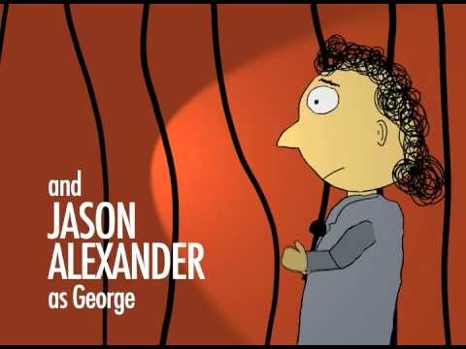
Why IMDB?
IMDB is a movie database that including cast, production crew, personnel and fictional character biographies, plot summaries, trivia, and fan reviews and ratings.

Slide 5

The technology tools that I have been used for this project?

Slide 6
To test it your website works or not

Slide 7
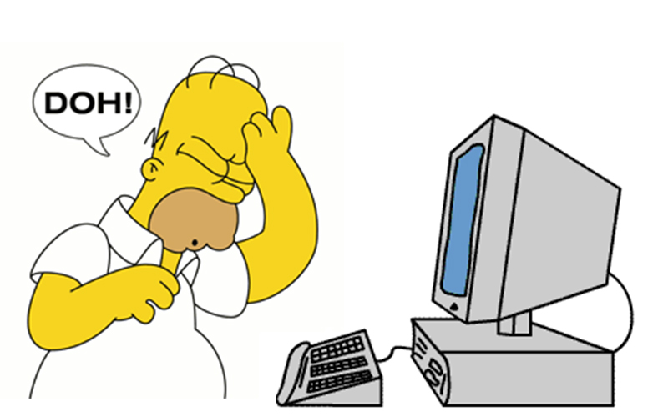
If not?
r.status_code will return
403.
Then, you will get
frustrated like this!

Slide 8
Top 10 Movies with TV shows Ratings

Slide 9
Votes

Slide 10
Top 10 Movies Ratings

Slide 11
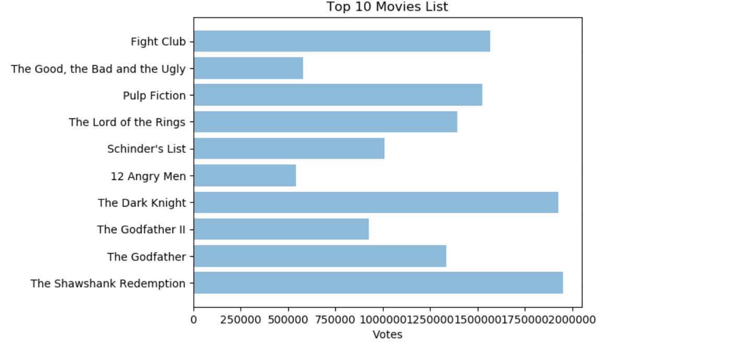
Votes

Slide 12
Lowest Rating (Bottom) 10 Movies or TV Shows

Slide 13
Votes

Slide 14

Conclusion
IMDB is a very interested project, everyone enjoys the TV shows and Movies.
It is a great resource to see which movies (TV shows) are worthy to watch and some are completely wasting time to watch.

